Slide 1
Front End Engineering-I Project
Team Details: Team Members-
1) Chetan Ajmani
(Roll No. 2410990215)
2) Bhavya Jain
(Roll No. 2410990194 )
3) Aayush Yadav
(Roll No. 2410990163 )
Faculty Coordinator: Dr. Neha Sharma
:
Chitkara University Institute of Engineering and Technology,
Chitkara University, Punjab

Slide 2
Table of Contents
Introduction
Problem Statement
Technical Details
Key Features
Project Highlights
Bonus Feature(optional)
Conclusion
References/Links used

Slide 3

Introduction
Title- Weather Forecasting App
“Empowering Decisions with Accurate Weather Insights”
Team Members- 1) Chetan Ajmani
(Roll No. 2410990215)
2) Bhavya Jain
(Roll No. 2410990194 )
3) Aayush Yadav
(Roll No. 2410990163 )

Slide 4
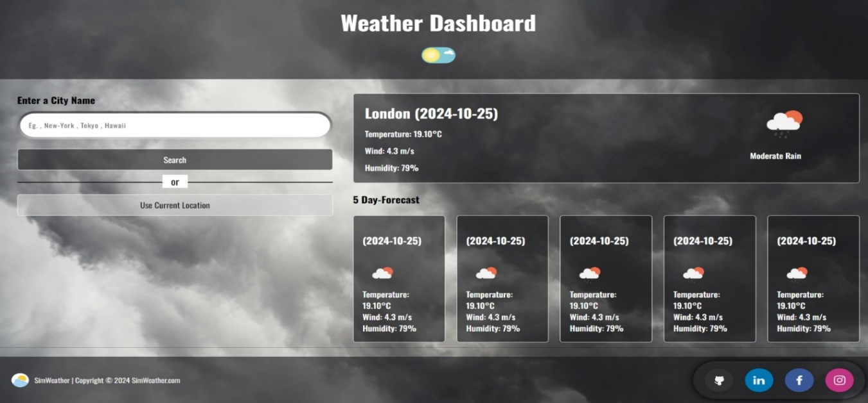
Introduction
“Why is this website important ?”: Our website aims to simplify access to critical weather information , offering a simple and clean UI for viewing forecasts , severe weather alerts , and climate data.
Goals For The Website: WE aim to make our website(or app) accessible for anyone who needs up-to-date weather information including travelers , outdoor enthusiasts , farmers , and everyday users.

Slide 5
Problem Statement
In our research, we identified two significant challenges that people face regarding weather updates:
1) Problem 1(Overwhelming Notifications): Many existing apps overwhelm users with notifications often irrelevant to their immediate use.
2) Problem 2(Lack of Local Recommendations): Users often seek not only weather information but also suggestions for nearby activities based on current conditions. Without timely and relevant recommendations users may miss out on their plans to go for an outing.

Slide 6
Technical Details
So, as to bring our project to reality we used various technologies to make it functioning, for example:
1) HTML: To create the basic structure for our website.
2) CSS: To style the main web page.
3) Java-script: To create a slide out animation.
4) Various AI tools to help us with new ideas as well as technologies.
5) VS code: As our primary code editor.
6) Version Control: Using Git for collaborative development and to track changes in our codebase.
7) Open Weather Map API-
Comprehensive Data Access: The Open Weather Map API provides access to a vast array of weather data, including current conditions, forecasts, and historical data for numerous locations worldwide.
Reliable and Accurate Forecasts: By using a well-established and constantly updating API, your app can deliver reliable and precise weather information to users. This builds trust and ensures users can plan their activities based on accurate data.

Slide 7
Key Features
After a thorough research we found some solutions that we think are best to tackle the problems stated in the previous slides:
Problem 1:
Solution: We will allow users to pin their favourite locations so they will receive notifications for those locations only.
2) Problem 2:
Solution: We will offer users personalized recommendations for local outings
based on real-time weather conditions, including the best time to visit those locations.

Slide 8
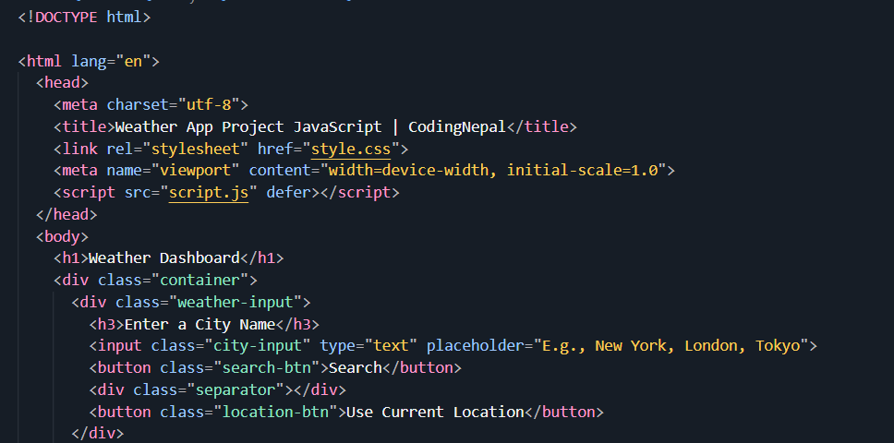
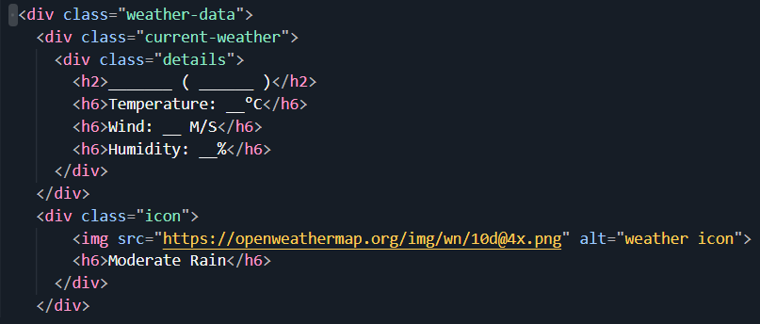
Project Highlights
1) HTML STRUCTURE:

Slide 9
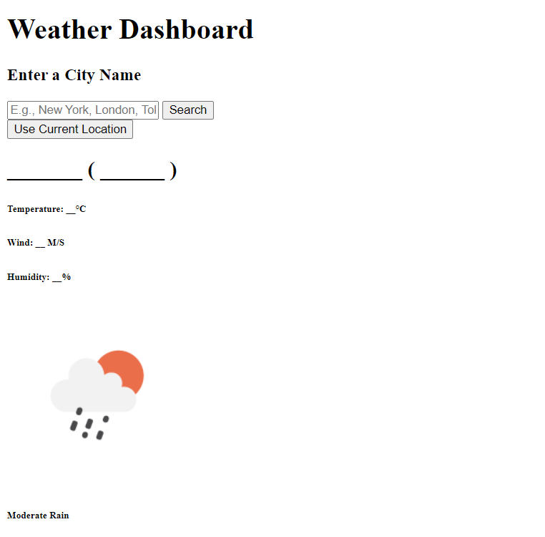
OUTPUT (HTML):

Slide 10
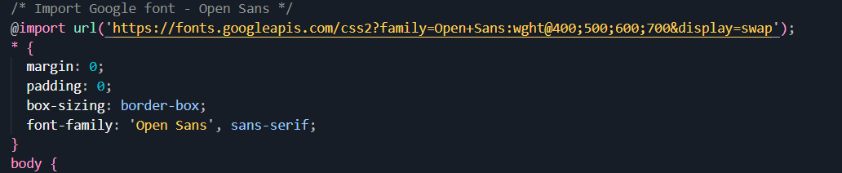
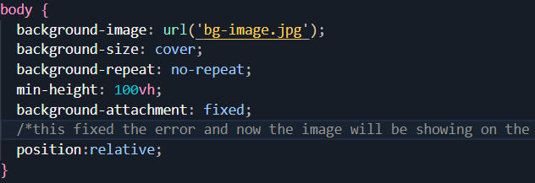
Some of the Important CSS code snippets:

Slide 11
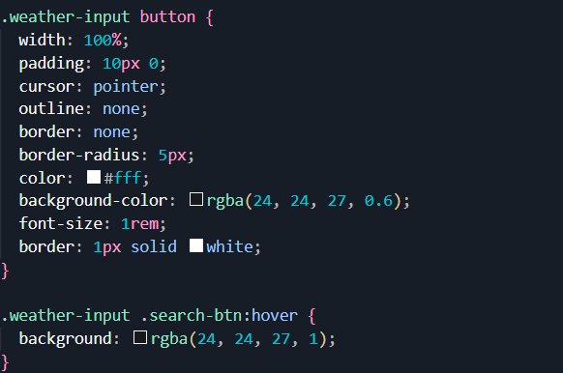
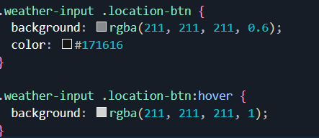
CSS for Search Button and HOVER effect:

Slide 12
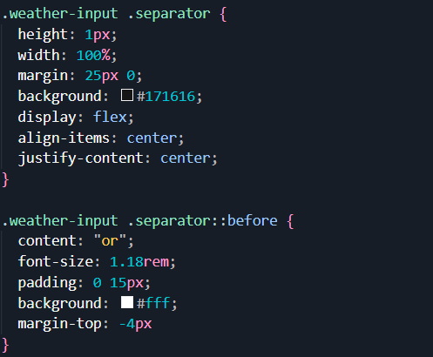

Slide 13
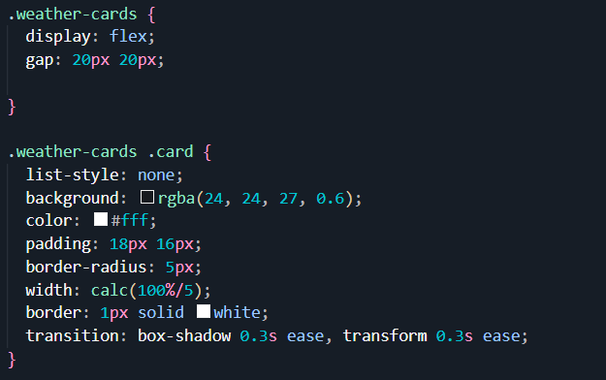
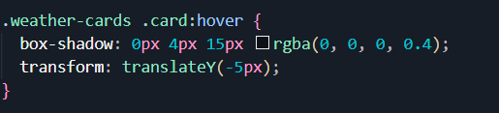
Weather Cards:
Hover on cards:

Slide 14
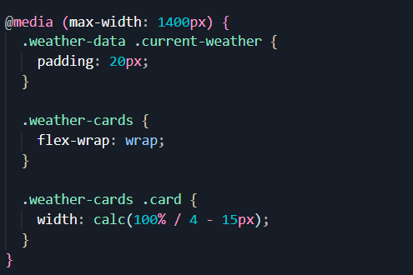
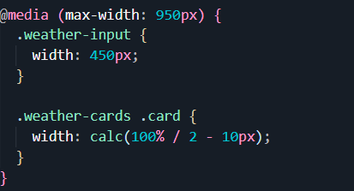
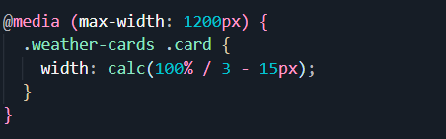
Media Queries:

Slide 15
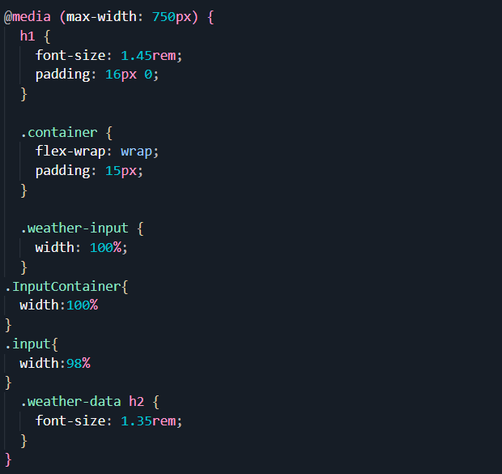

Slide 16
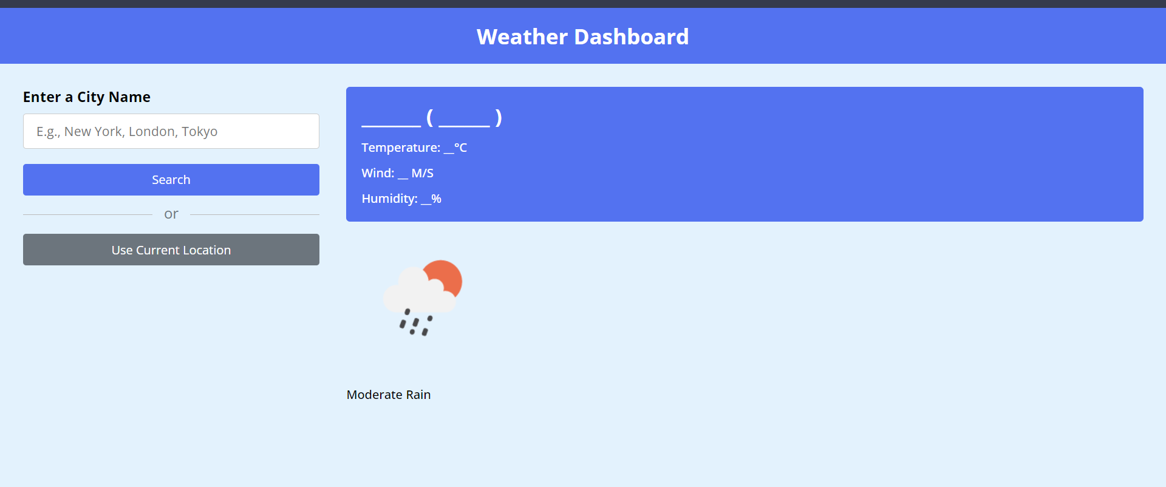
OUTPUT 2( AFTER CSS):

Slide 17
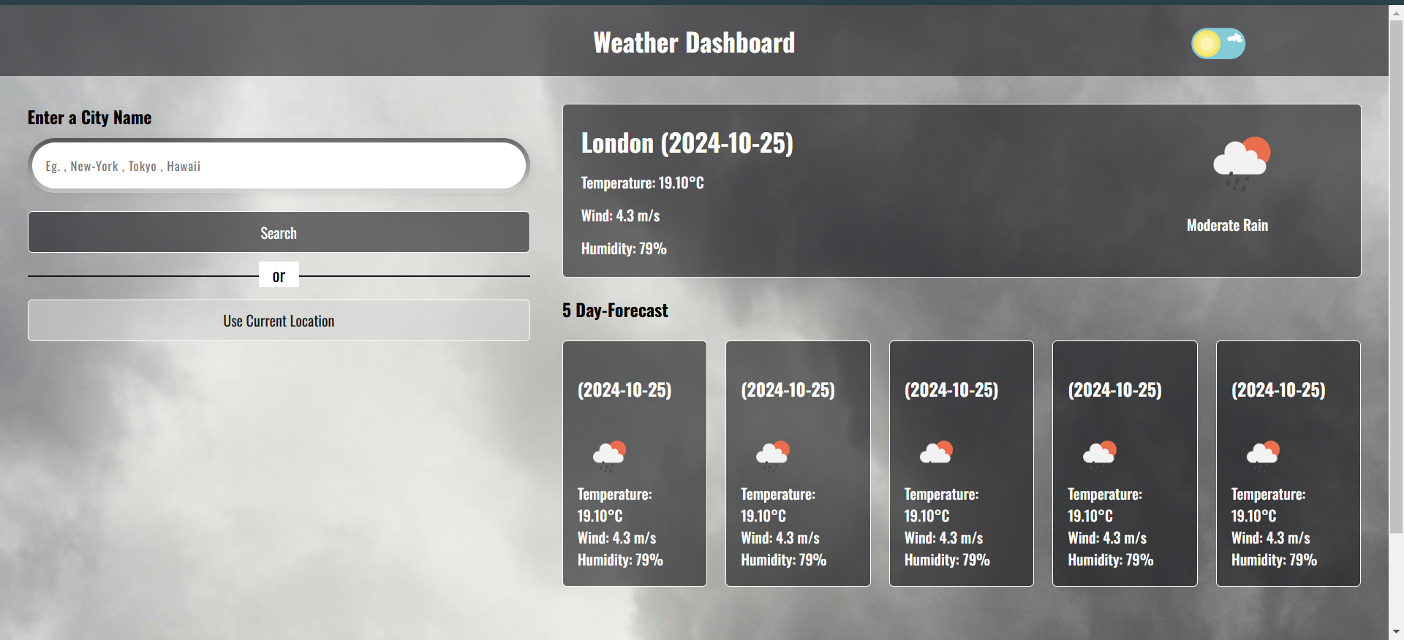
OUTPUT 3:

Slide 18
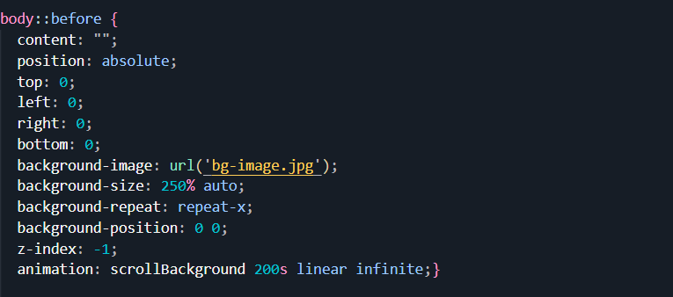
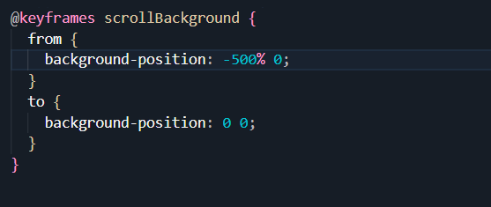
Creating Transition for Background using CSS:

Slide 19
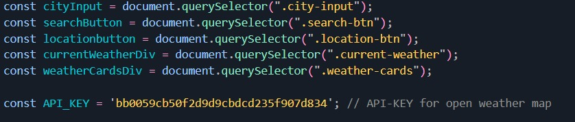
Javascript Code Snippets:
Defining Variables

Slide 20
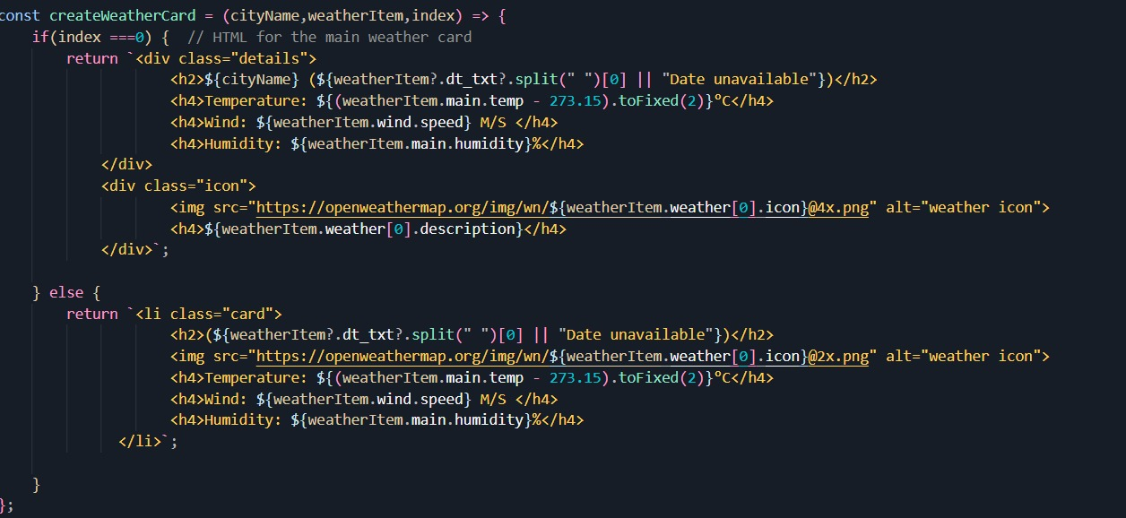
Defining Function for Fetching API

Slide 21
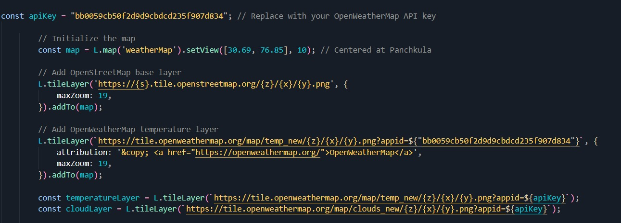
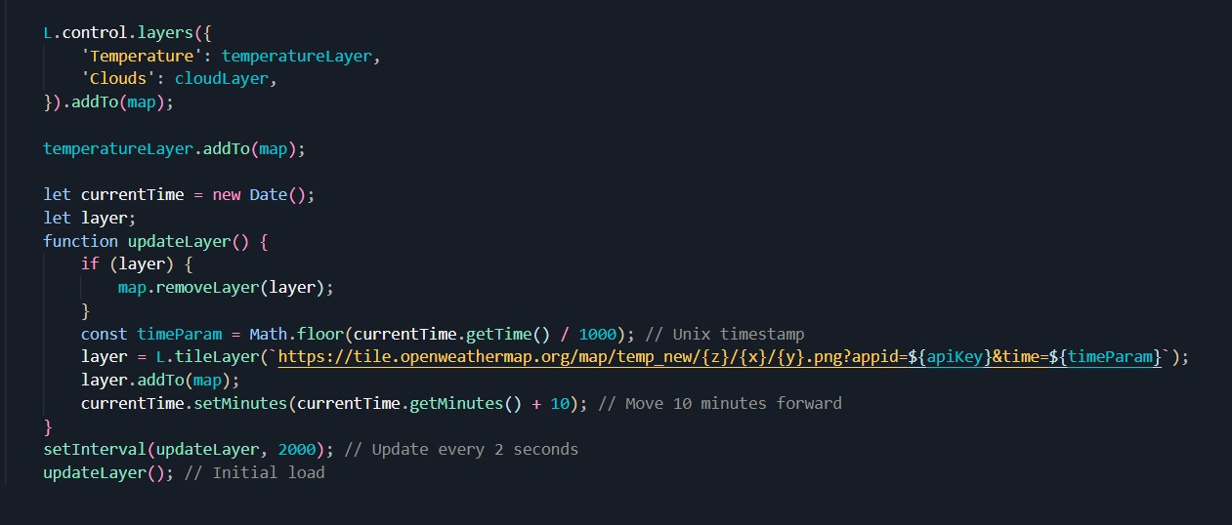
Fetching Live Map for API

Slide 22
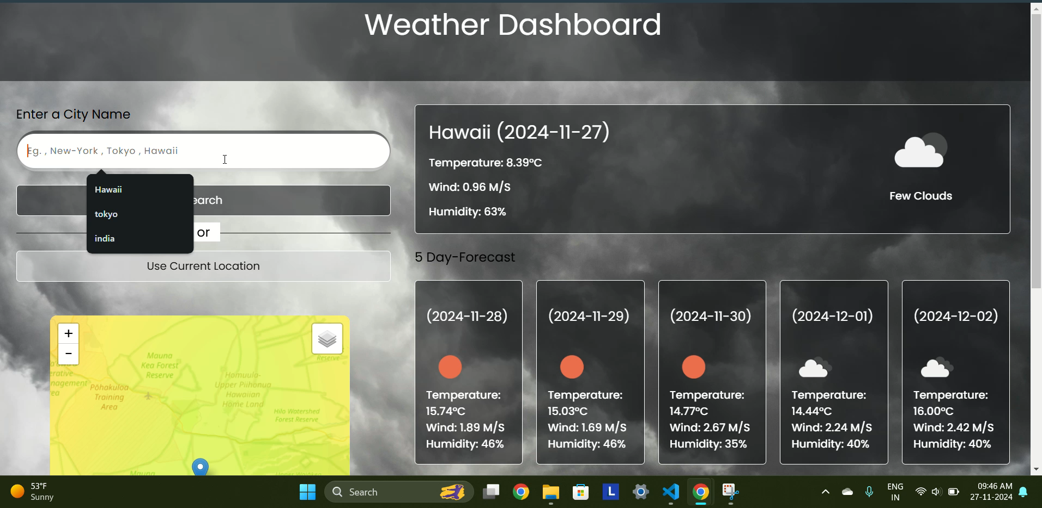
Final Output:

Slide 23
Conclusion
By and large, our project aims to provide users with a one-stop solution for checking weather conditions and planning their next trip.
Moving forward, we will focus on enhancing the user experience by developing a more intuitive and seamless interface. Additionally, we plan to improve the functionality of our website by incorporating JavaScript and an API key to fetch real-time weather data.
Thank you for your attention! We’re excited to hear your thoughts and answer any questions you may have.

Slide 24
References/Links used
HTML [1]
CSS [2]
JAVASCRIPT [3]
YOUTUBE [4]
Uiverse.io [5]
GOOGLE FONTS [6]
PHOTOS [7]
Idea/Source-Code [8]
Open Weather Map [9]

Slide 25


